Slide 1
Logistic Regression

Slide 2
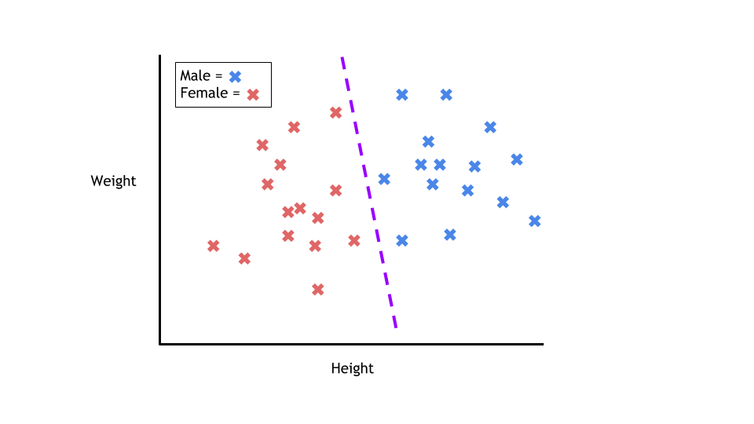
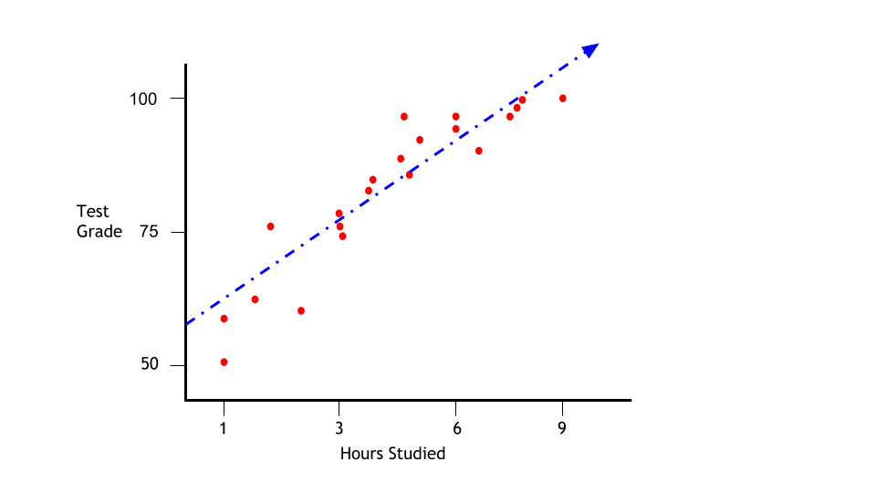
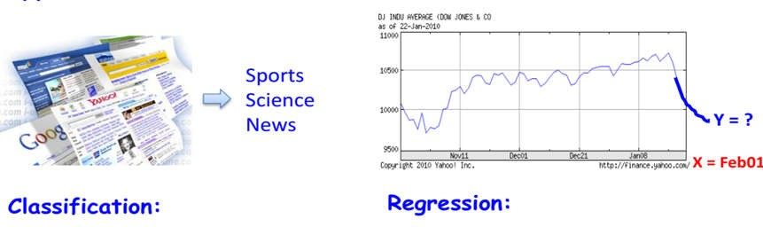
Prediction Problems: Discrete and Continuous Labels

Slide 3
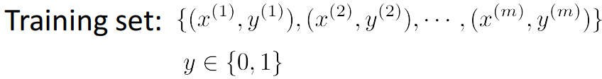
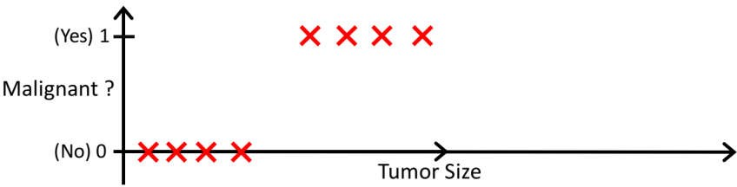
Example Classification Problem
Tumor: Malignant / Benign ?
0: “Negative Class” (benign tumor) 1: “Positive Class” (malignant tumor)
slides taken from course materials of Andrew Ng

Slide 4
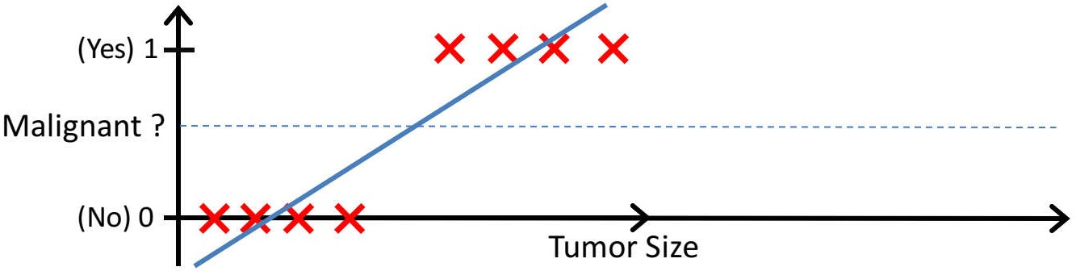
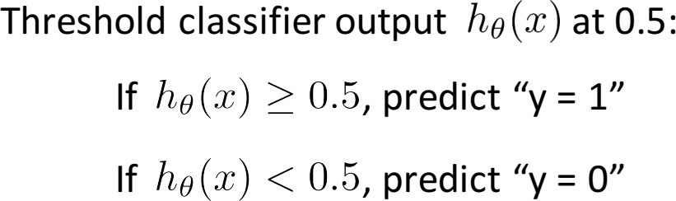
Can we solve using linear regression?
Fit a straight line and define a threshold
slides taken from course materials of Andrew Ng

Slide 5
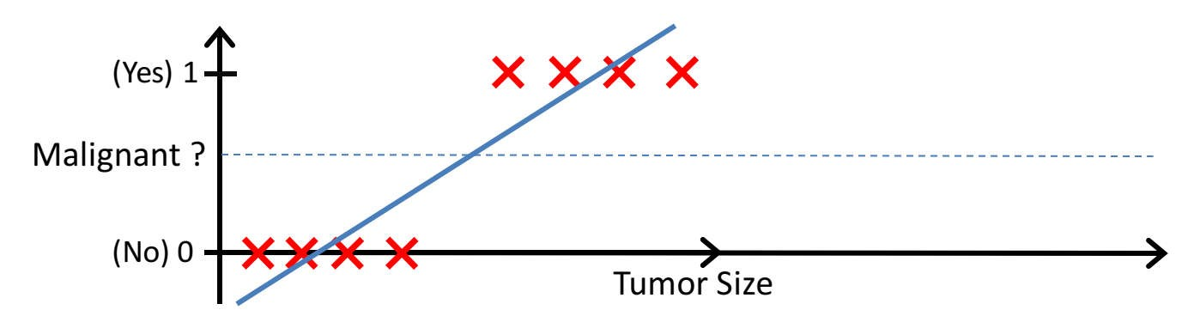
Can we solve using linear regression?
Add a new data point
H(x) can be > 1 or < 0

Slide 6
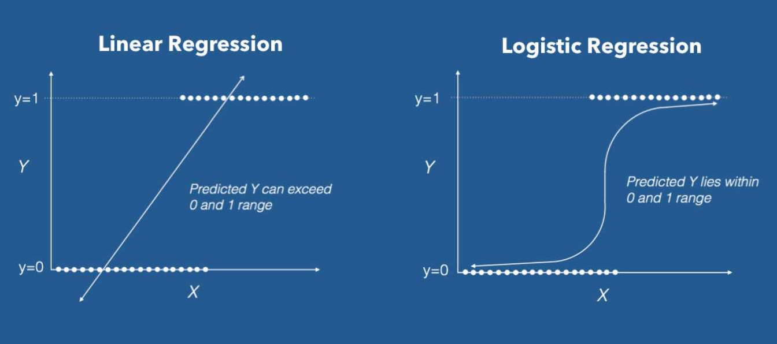
How to limit h(x)?
Linear Regression VS Logistic Regression Graph| Image: Data Camp

Slide 7
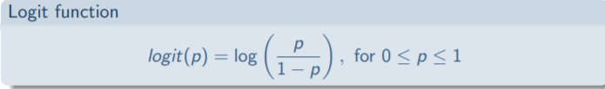
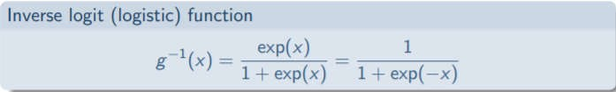
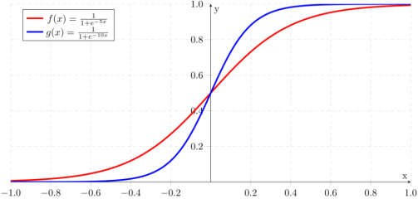
Logit and Logistic Function
Odds - ratio of success to ratio of failure
The logit function, denoted as "logit(p)" for a probability "p," is defined as the natural logarithm of the odds of the event occurring (p) to the odds of it not occurring (1 - p). It transforms a probability value into a real number on the entire real number line.
The logit function takes a value between 0 and 1 and maps it to a value between −∞ and ∞
The inverse logit function takes a value between −∞ and ∞ and maps it to a value between 0 and 1
Sigmoid function​

Slide 8
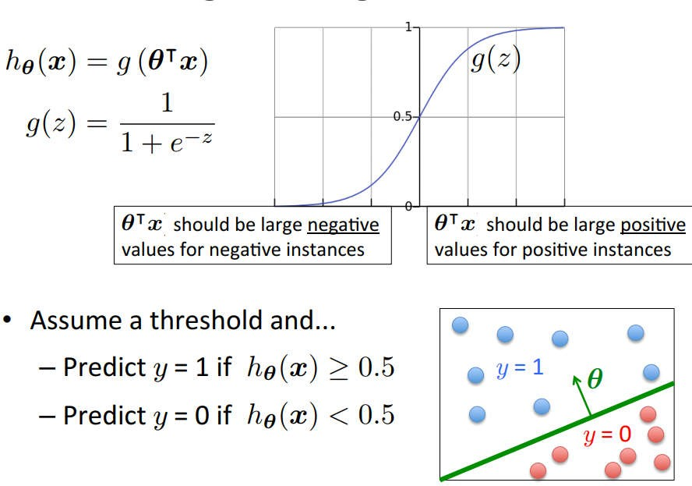
Logistic Regression Model
Interpretation of Hypothesis Output
Tell patient that 70% chance of tumor being malignant

Slide 9
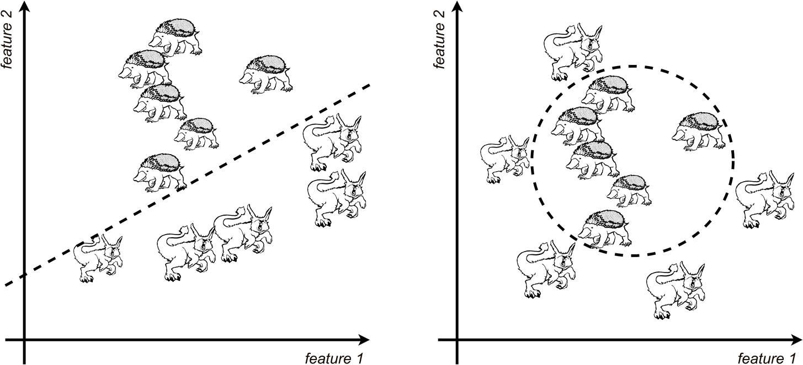
Linear Separability
Decision Boundary
Finding a good decision boundary => learn appropriate values for the parameters
Linear separable (on the left) and nonlinear separable (on the right) data. The decision boundary as shown in the dashed line. Source: Mykola Sosnovshchenko

Slide 10
Summary
Logistic Regression is a classification algorithm
Hypothesis use a sigmoid function to map output to 0-1 range
Output is the estimated as a probability

Slide 11
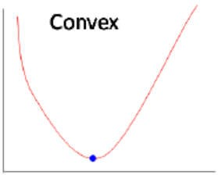
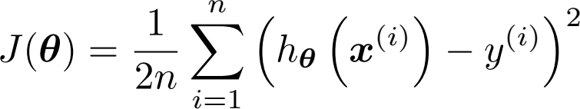
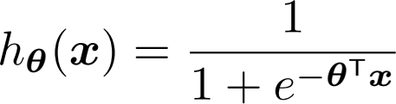

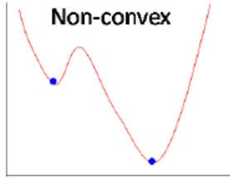
Cost Function
Linear Regression Squared error cost function
Nonlinear function in logistic regression
results in a non-convex optimization Assume that

Slide 12
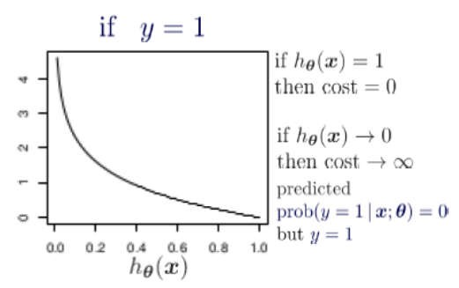
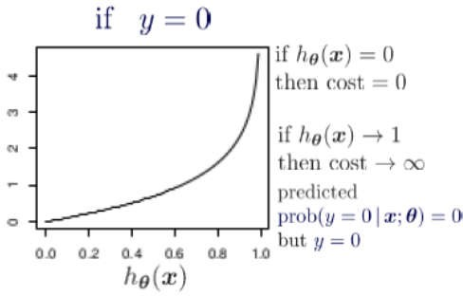
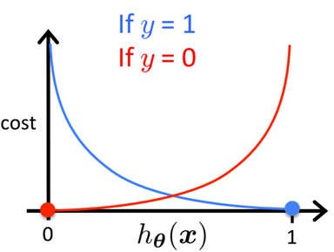

Cost Function
log loss error function

Slide 13
Maximum Likelihood Estimation (MLE)
To chose values for the parameters of logistic regression
(1) write the log-likelihood function
(2) find the values of θ that optimize the log-likelihood function

Slide 14
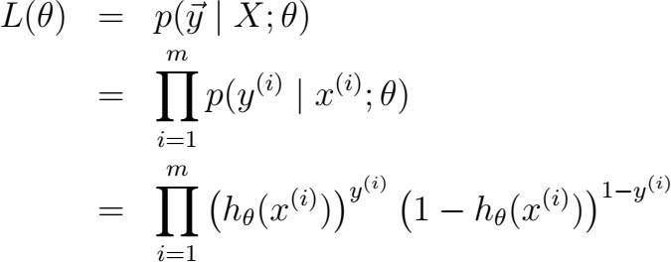
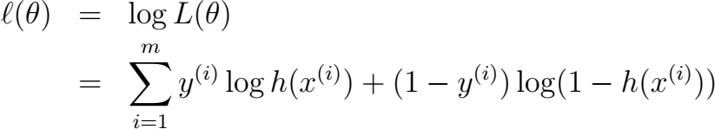
1. log-likelihood function
likelihood
log likelihood

Slide 15
2. optimize log-likelihood function
No closed form for the maximum
Best values of theta by using an optimization algorithm
Compute partial derivative of log likelihood with respect to each parameter

Slide 16
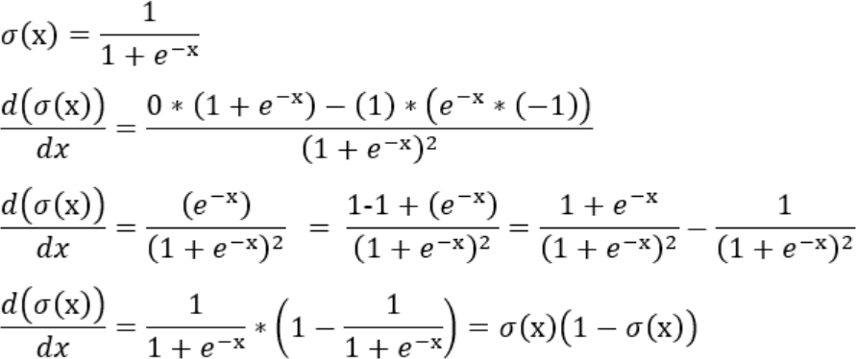
Derivative of Sigmoid Function

Slide 17

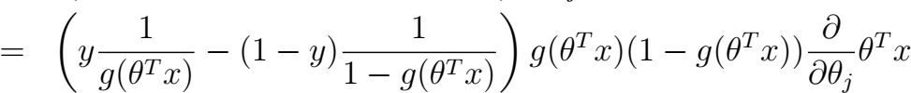

Partial derivative of log-likelihood

Slide 18

Gradient Descent Optimization
partial derivative of log likelihood with respect to each parameter
Take small steps in the direction of gradient, to reach local maximum

Slide 19

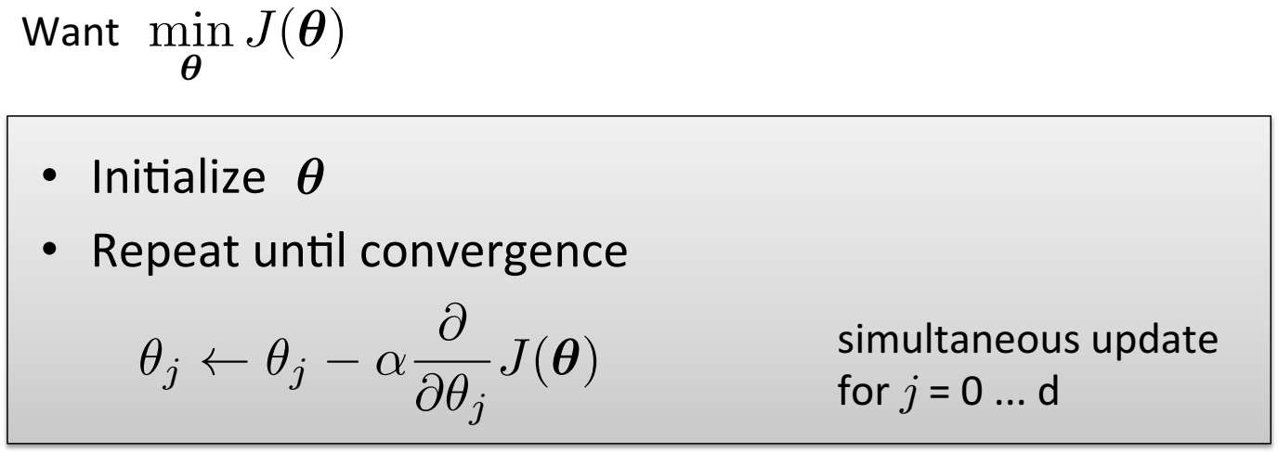
Gradient Descent for Logistic Regression

Slide 20
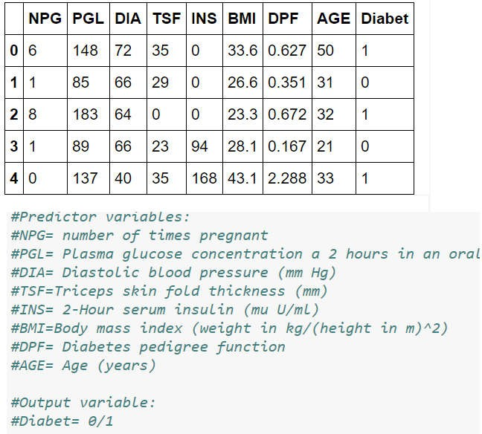
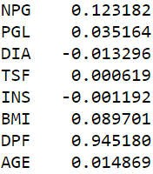
Example
Learned Parameters
Model
y= sigmoid(t0 + t1*NPG + t2*PGL+ t3*DIA
+ t4*TSF + t5*INS + t6*BMI + t7*DPF + t8*AGE )
Test data
<8,196,30,38,230,45,0.180,34>
P= 0.971684882874
97% chance of the above patient getting
diabetes

Slide 21
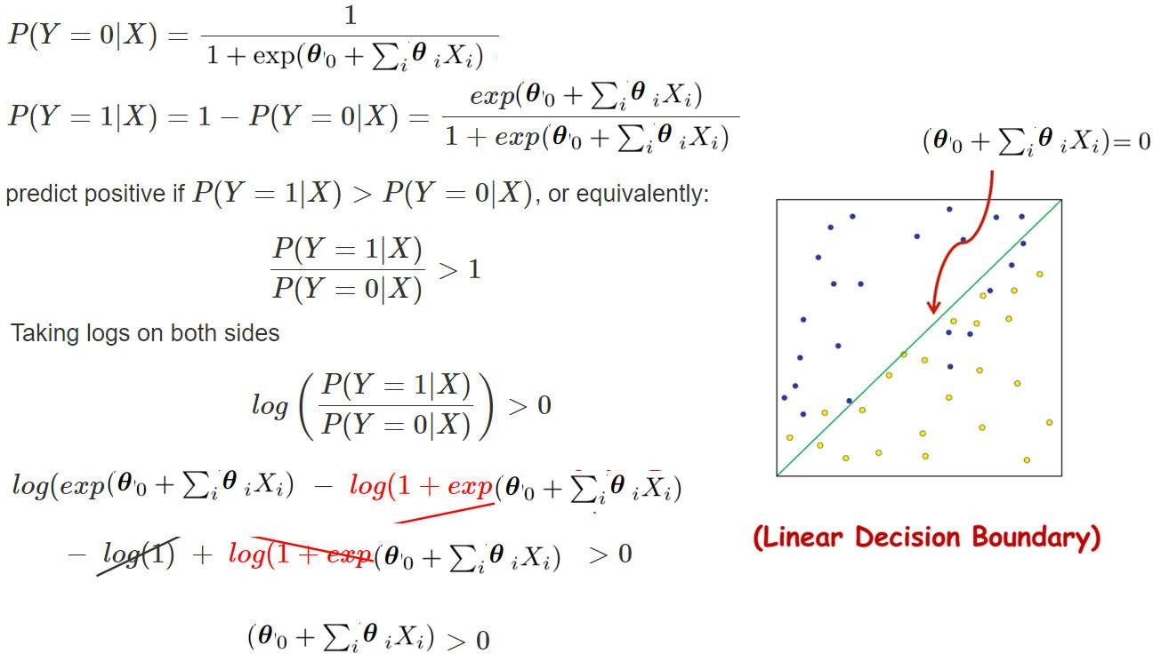
Is Logistic Regression a Linear Classifier ?

Slide 22
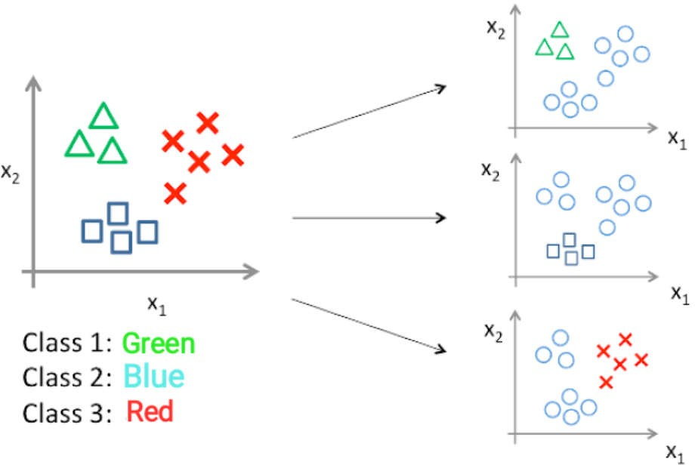
Multiclass Classification
One vs. All:- N-class instances then N binary classifier models
One vs. One:- N-class instances then N* (N-1)/2 binary classifier models
Classifier 1:- [Green] vs [Red, Blue]
Classifier 2:- [Blue] vs [Green, Red]
Classifier 3:- [Red] vs [Blue, Green]

Slide 23
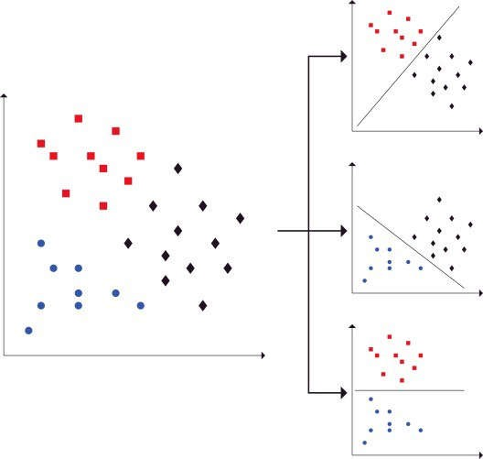
Multiclass Classification
One vs. One:- N-class instances then N* (N-1)/2 binary classifier models
Split the dataset into one binary classification dataset for each pair of classes
N* (N-1)/2 = 3
Classifier 1: Red vs. Black
Classifier 2: Blue vs. Black
Classifier 3: Blue vs. Red
model with majority
https://towardsdatascience.com/multi-class-classification-one-vs-all-one-vs-one-94daed32a87b

Slide 24
Probabilistic classifier
A feature representation of the input.
A classification function that computes the estimated class, via
p(yIx). Ex. sigmoid
An objective function for learning, loss function
An algorithm for optimizing the objective function. gradient descent algorithm

Slide 25


Discriminative Classifier
Problem: To distinguish dog images from cat images
Discriminative model
learn to distinguish the classes without learning much about them
Estimate parameters of P(Y|X) directly from training data
Generative model
Estimate parameters of P(X|Y), P(Y) directly from training dat
Indirect computation of P(Y|X) through Bayes rule
Logistic Regression is a Discriminative model

Slide 26
Summary
Logistic Regression is a probabilistic classifier p(y|x)
Logistic Regression is a linear classifier
decision rule is a hyperplane
Logistic Regression is a discriminative classifier
Uses sigmoid function to map output to 0-1 range
Uses a log loss error function
Logistic Regression is optimized by conditional likelihood
no closed-form solution
global optimum with gradient descent
26

